Slide 1
"Digital Media Primer" Yue-Ling Wong,
Copyright (c)2013 by Pearson Education, Inc. All rights reserved.

Slide 2
Chapter 2
Fundamentals of Digital Imaging
Part 2
Bitmapped Images vs.
Vector Graphics

Slide 3
In this lecture, you will find answers to these questions
What are bitmap images?
What are vector graphics?
What do aliasing and anti-aliasing mean?

Slide 4
Bitmapped images
Examples:
Web images, e.g. JPEG, PNG, GIF
Adobe Photoshop images

Slide 5
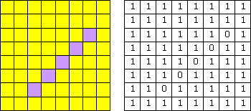
Bitmapped images
Characteristics
the image is divided in a grid (think of it as a pegboard)
each cell (think of it as a peghole) in the grid stores only one color value (think of it as a peg)
each cell is called a pixel—picture element
bitmap images are resolution dependent; each image has a fixed resolution
the level of details the image can represent depends on the number these cells, or pixels.
A pegboard with more holes lets you create a picture with finer details.
cells

Slide 6
Bitmapped images
If I specify "1" to represent yellow and "0" to represent purple,
the data to describe this image is:
1111111111111111111111011111101111110111111011111101111111111111
The size of the data (the file size) in this example—an 8x8-pixel image is not too bad, but what about we have a 3000x2000-pixel—an image from a 6-megapixel digital camera?

Slide 7
Bitmap vs. Pixmap
Bitmap: In certain contexts, it refers to images with 1 bit per pixel, i.e., each pixel has a value either 0 or 1.
Pixmap: If each pixel has a color value that uses more than 1 bit.
Here we are using the term bitmap or bitmapped images to refer to all pixel-based images.

Slide 8
Vector Graphics
Examples: graphics created in
  Adobe Flash
  Adobe Illustrator

Slide 9
Vector Graphics
Characteristics
Generated mathematically,
i.e. instructions
not pixel-based
Resolution independent

Slide 10
Vector Graphics Instruction Example
A simple postscript example:
  %!
  newpath
  200 200 moveto
  300 200 lineto
  stroke
  showpage

Slide 11
Bitmap Images vs.
Vector Graphics
An analogy:
  Driving Directions:
  A visual map vs. a written instruction
Bitmap ~~> map
Vector Graphics ~~> a written instruction

Slide 12
Bitmap Images vs.
Vector Graphics
An analogy:
  Driving Directions:
  A visual Triptik map vs. a written instruction
Which one takes up more storage space?
  Triptik map ~~> bitmap
Which one takes you more time to translate the direction into a mental image?
  written instruction ~~> vector graphics (take more computation to display on computer because it is mathematically generated)

Slide 13
Bitmap Images vs.
Vector Graphics
An analogy:
  Driving Directions:
  A visual Triptik map vs. a written instruction
If you are going to draw out a map based on a written instruction, how big can you draw?
  as big as you physically can ~~> the instruction is resolution independent

Slide 14
Bitmap Images vs.
Vector Graphics
1111111111111111111111011111101111110111111011111101111111111111
  %!
  newpath
  2 1 moveto
  6 5 lineto
  stroke
  showpage
vector graphic
bitmap image

Slide 15
Vector Graphics
The unit is arbituary, i.e. when you print out an image, you may set one unit as an inch or a foot.
This means vector graphic is resolution independent.
  %!
  newpath
  2 1 moveto
  6 5 lineto
  stroke
  showpage
vector graphic

Slide 16
Printing Bitmap Images
have the same amount of data, i.e. same level of details
print bigger
print smaller
bitmap image

Slide 17
Printing Vector Graphics
print bigger
print smaller
vector graphics

Slide 18
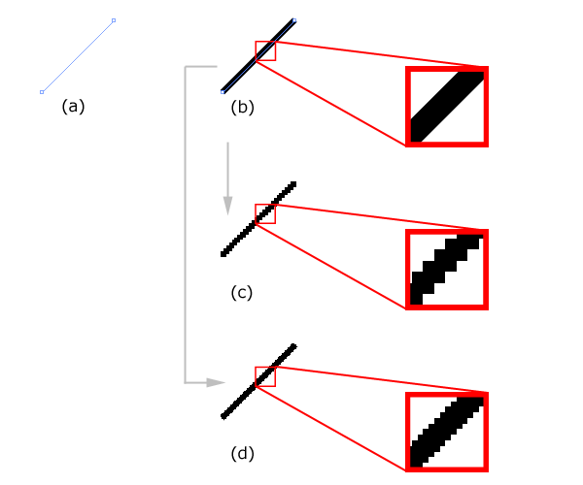
Bitmap Images vs. Vector Graphics
Example
Vector graphics:A line defined by two end points.
Vector graphics: The same line is stroked with a certain width.
& (d) The line is converted to a bitmap.

Slide 19
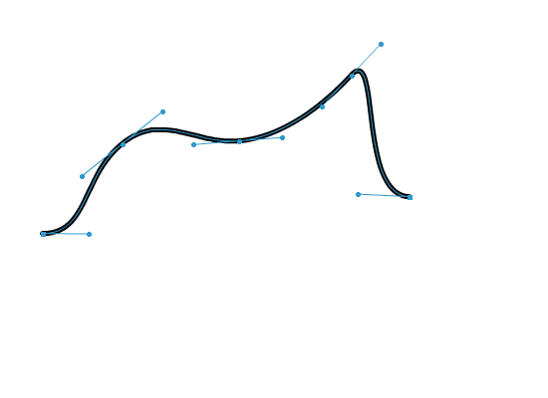
Curve Drawing in Vector Graphics Programs
defined by a set of points;
we call them anchor points
the direction handles or tangent handles of a point controls the tangent at that point on the curve

Slide 20
Rastering Vector Graphics
Raster means convert vector graphics into pixel-based images.
Most vector graphics programs let you rasterize vector graphics.
Need to specify a resolution for rasterizing, that is, how coarse or how fine the sampling.

Slide 21
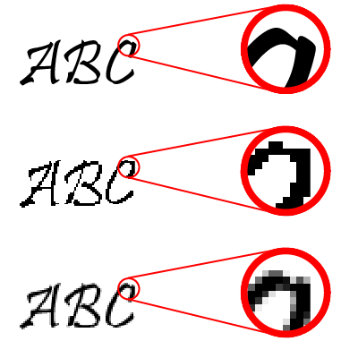
Aliasing
The rasterized image will appear jagged.
This jagged effect is a form of aliasing caused by undersampling (which means insufficient sampling rate.) Recall the musical note on a pegboard example.
Original vector graphics
Rastered vector graphics without anti-aliasing

Slide 22
Anti-aliasing Techniques
To soften the jaggedness by coloring the pixels with intermediary shades in the areas where the sharp color changes occur.
Original vector graphics
Rastered vector graphics without anti-aliasing
Rastered vector graphics with anti-aliasing

Slide 23
Review Questions
Note to instructor:
Depending on your preference, you may want to go over the review questions at the end of this lecture as an instant review or at the beginning of next lecture to refresh students' memory of this lecture.

Slide 24
Review Question
Bitmapped images are composed of ___.
A. individual pixels which represent spatial samples of the image or scene
B. mathematical descriptions of image elements which include points, lines, curves, and figures
Notes:
A

Slide 25
Review Question
Vector graphics are composed of ___.
A. individual pixels which represent spatial samples of the image or scene
B. mathematical descriptions of image elements which include points, lines, curves, and figures
Notes:
B

Slide 26
Review Question
The main advantage(s) of bitmapped images over vector graphics is (are) ___.
A. scalability (ie., resolution independence of images)
B. ease of editing the image content pixel by pixel
C. more compact file size compared to vector graphics
Notes:
B

Slide 27
Review Question
The main advantage(s) of vector graphics over bitmapped images is (are) ___.
A. scalability (ie., resolution independence of images)
B. ease of editing the image content pixel by pixel
C. more compact file size compared to vector graphics
Notes:
A and C

Slide 28
Review Question
Sometimes when you magnify a picture on your computer screen, lines that should be straight lines appear to be jagged. This effect is called ___.
A. anti-aliasing
B. aliasing
C. dithering
D. indexing
Notes:
B

